Slide 1
1.1.2 Examining Distributions AP Statistics
Distribution- the pattern of variation of a variable.
In any graph of data, look for the overall pattern and for striking deviations from that pattern
You can describe the overall pattern of a distribution by its specific characteristics

Slide 2
Describing Distributions (G-SOCS)
Gaps
Shape
Outliers (unusual features)
CENTER
SPREAD

Slide 3
CENTER
The center of the distribution is described by its midpoint.
Roughly half of the observations taking smaller values, and half taking larger values.

Slide 4
SHAPE
Modes-Peaks in the distribution
Does the distribution have one or several peaks?
One major peak- Unimodal
Two Peaks- Bimodal
One Peak
Bell (or Mound) shaped- Distribution is symmetric about the midpoint
Skewed Right – The tail is on the right with most values in distribution pushed to the left
Skewed Left – The tail is on the left with most values in distribution pushed to the right

Slide 5
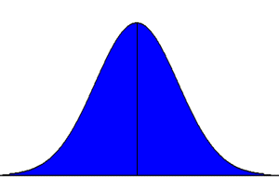
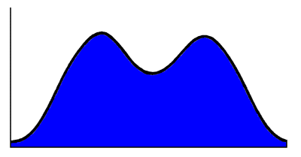
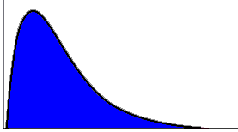
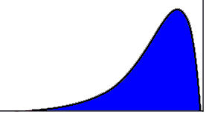
SHAPE
Unimodal-Mound shaped – we call this bell shaped
Bimodal
Skewed Right
Skewed Left
**If a shape is multi-modal, we usually call it “relatively mound”

Slide 6
SPREAD
Described by giving the largest and the smallest values of the distribution

Slide 7
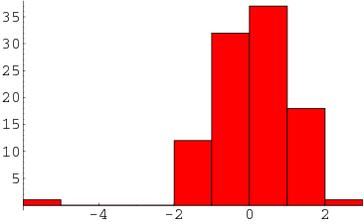
UNUSUAL FEATURES
Outliers
An outlier is an observation that lies an abnormal distance from other values
Look for points that are clearly apart from the body of the data, not just for the most extreme observations

Slide 8
HOMEWORK
Pg. 55 # 1.7, 1.8, 1.9, 1.10, 1.12
and Read Ex. 1.7 on pg. 53 & 1.8 on pg. 54
***Read Pages 60-63 on Relative & Cumulative Frequencies and on Time Plots.
***Enter the important information into your notes

